Slide 1

Algorithms and Data Structures 1 CS 0445
Fall 2023
ADT Dictionary
Sherif Khattab
ksm73@pitt.edu
(Slides are adapted from Textbook slides and Dr. Ramirez’s CS 0445 slides)

Slide 2
Announcements
Upcoming Deadlines:
Programming Assignment 4: Friday 11/17 @ 11:59 pm
You can use the code explained in last week’s support session
Programming Assignment 5: Friday 12/8 @ 11:59 pm
Nothing due over the break; Take a good rest!

Slide 3


Sorting Algorithms
Efficiency of sorting is significant
O(n²)
O(n log n) – optimal for comparison sort
O(n)
Radix Sort (non-comparison sort)
 | In-place | Stable | Adaptive | Other
Bubble Sort
Selection Sort |  |  |  | progressive
Insertion Sort
Shell Sort
Merge Sort |  |  |  | optimal
Quick Sort |  |  |  | O(n log n) on average

Slide 4
Radix Sort
Does not use comparisons
array entries are strings of digits or characters
basic idea: sort by distribution
group based on rightmost character (digit) into buckets
Repeat with next character (digit), etc.

Slide 5
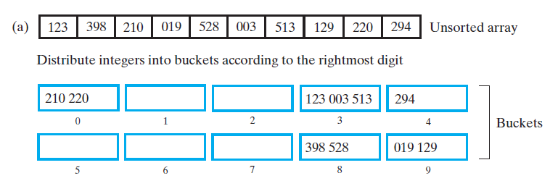
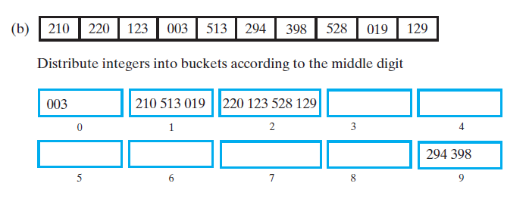

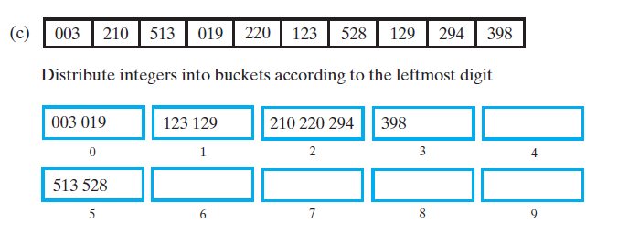
Radix Sort - Example

Slide 6
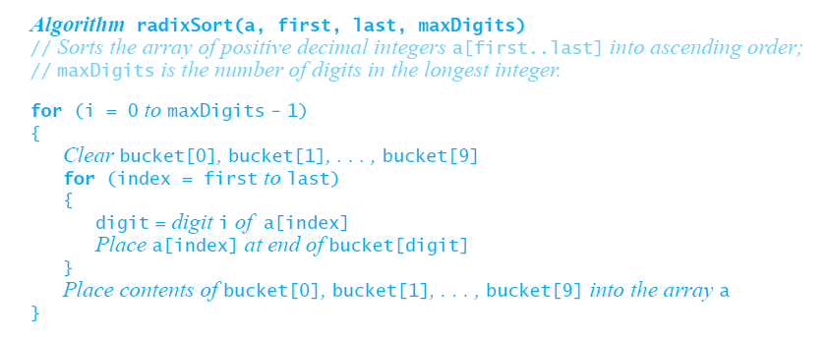
Pseudocode for Radix Sort

Slide 7
Runtime for Radix Sort
Radix sort is an O(w*n) algorithm
w is number of digits per integer
Works for digital data types

Slide 8
Radix Sort Variation
group based on leftmost character into buckets
Sort buckets recursively starting from next character

Slide 9
Sorting Algorithms
O(n²)
O(n log n)
O(n)
 | In-place | Stable | Adaptive | Other
Bubble Sort
Selection Sort |  |  |  | progressive
Insertion Sort
Shell Sort
Merge Sort |  |  |  | optimal
Quick Sort |  |  |  | n log n on avg
Radix Sort |  |  |  | optimal

Slide 10
Wouldn’t it be wonderful if...
Search through a collection in O(1) with relatively small extra space?

Slide 11
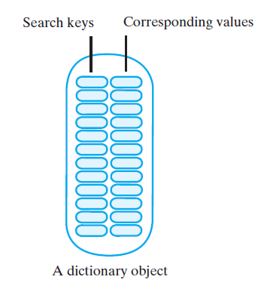
ADT Dictionary
A set of entries
each entry contains
Keyword (search key) and Value
Which other ADT also stores a set?

Slide 12
ADT Dictionary Interface
add(key, value)
remove(key)
getValue(key)
contains(key)
isEmpty()
getSize()
clear()

Slide 13
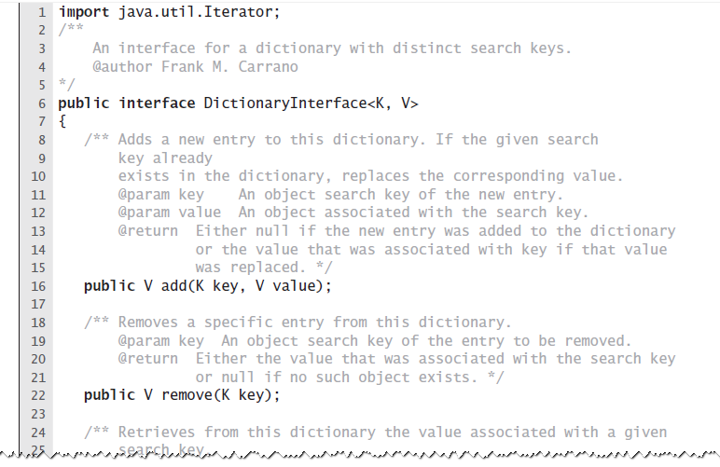
DictionaryInterface
Two type parameters (why?)

Slide 14
add

Slide 15
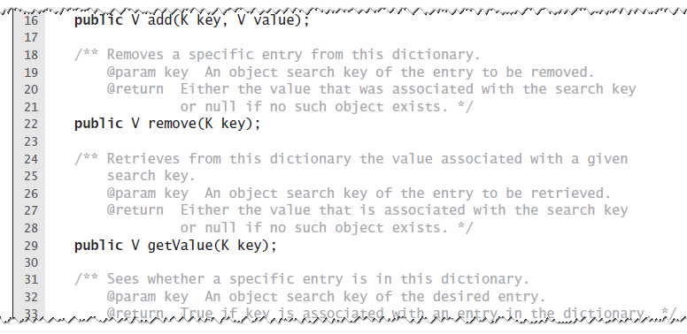
remove

Slide 16
getValue

Slide 17
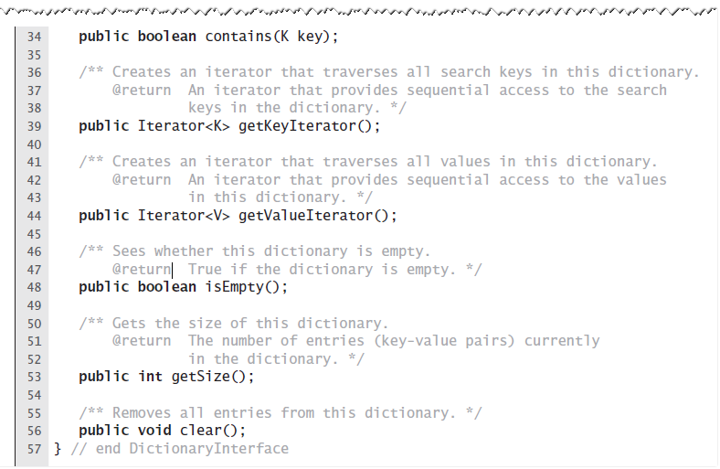
contains

Slide 18
isEmpty, getSize, clear

Slide 19
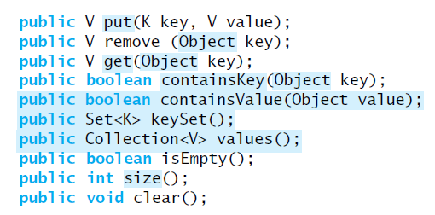
Java Class Library: Interface Map

Slide 20
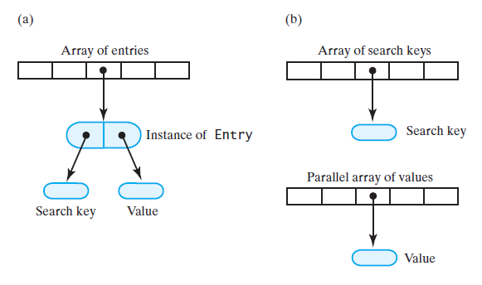
Array-Based Implementations
How would we store an array of pairs?

Slide 21
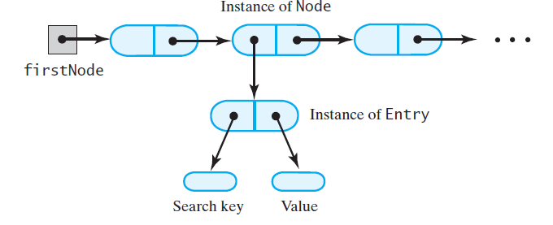
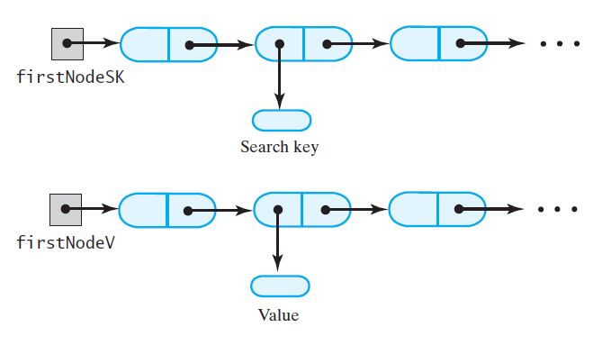
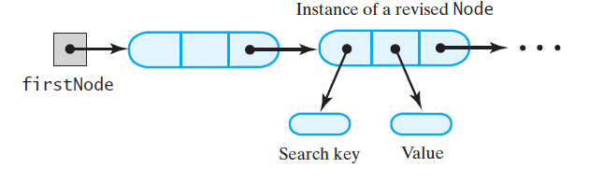
Linked Implementations

Slide 22
Hashing
Hashing: determine array index using only a key
Hash function
Given a key, produce an integer index in hash table
We say that key—maps, or hashes, to the index
Assume we have
an array of length m (call it HT)
a hash function h(x)
maps from keys to the set {0, 1, 2, …, m-1}
This is the basic premise of hash tables

Slide 23
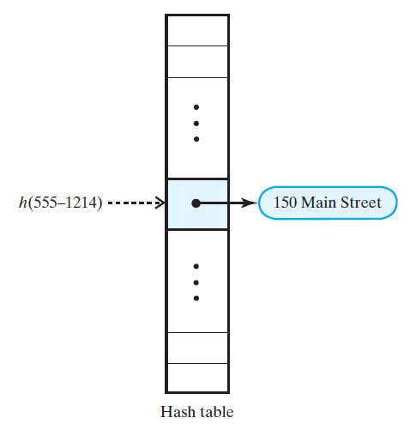
Ideal Hashing
1-1 mapping from keys to array indices

Slide 24
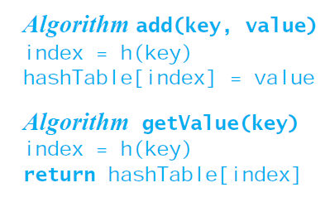
Ideal Hashing

Slide 25
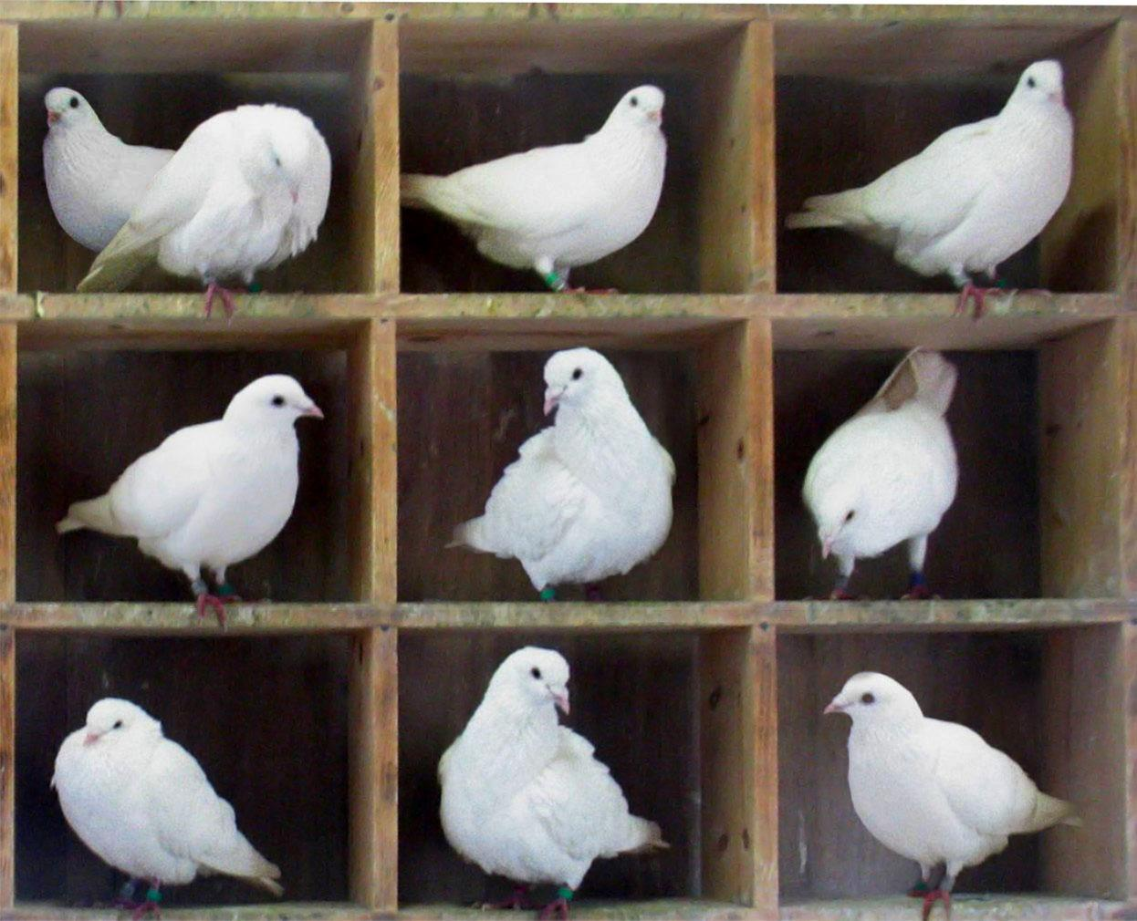
How do we search/insert with ideal hashing?
This is a very general, simple approach to a hash table implementation
Where will it run into problems?
What do we do if h(x) == h(y) where x != y?
Notes:
discuss implementing as a symbol table

Slide 26
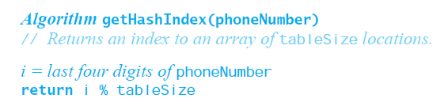
Typical Hashing
Typical hash functions perform two steps:
Convert key to an integer called the hash code
Compress hash code into range of hash table indices

Slide 27
Typical Hash Function are not perfect
Can map more than one key into a single index
Causes a collision in the hash table
Example
Consider tableSize = 101
getHashIndex(555-1264) = 52
getHashIndex(555-8132) = 52 also!!!

Slide 28
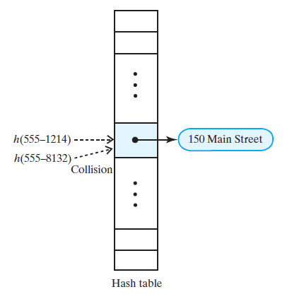
Collision
555-1264

Slide 29
Consider an example
Company has 500 employees
Stores records using a dictionary with 1000 entries
Employee SSNs are hashed into hash table,
Keys are SSNs, so |keyspace| == 10⁹
Specifically, used keys can’t be known in advance
Due to employee turnover
What if one employee (with SSN x) is fired and replacement has an SSN of y?
Can we guarantee h(y) does not collide with the 499 other SSNs?
Notes:
Nope!

Slide 30
Can we ever guarantee collisions will not occur?
Yes, if keyspace is smaller than our hash table
If |keyspace| <= m, perfect hashing can be used
i.e., a hash function that maps every key to a distinct integer < m
it can also be used if n < m and the keys known in advance
e.g., hashing keywords of a programming language during compilation
If |keyspace| > m and keys not known a priori, cannot avoid collisions
Notes:
|keyspace| is cardinality of the keyspace
Why not just make m = |keyspace|?
Simple perfect hashing function for integers!

Slide 31
Good Hash Functions
A good hash function:
minimizes collisions
fast to compute
To reduce the chance of a collision
Utilize the entire key
Exploit differences between keys
Distribute entries uniformly

Slide 32
Computing Hash Codes
Object has a method hashCode
returns an integer hash code
Classes should override hashCode
A hash code for a String
multiply ASCII/Unicode char value by place-value, then sum
called Horner’s method

Slide 33
Horner's method
Base 10
12345
= 1 * 10⁴ + 2 * 10³ + 3 * 10² + 4 * 10¹ + 5 * 10⁰
Base 2
10100
= 1 * 2⁴ + 0 * 2³ + 1 * 2² + 0 * 2¹ + 0 * 2⁰
Base 16
BEEF3
= 11 * 16⁴ + 14 * 16³ + 14 * 16² + 15 * 16¹ + 3 * 16⁰
ASCII Strings
HELLO
= 'H' * 256⁴ + 'E' * 256³ + 'L' * 256² + 'L' * 256¹ + 'O' * 256⁰
= 72 * 256⁴ + 69 * 256³ + 76 * 256² + 76 * 256¹ + 79 * 256⁰

Slide 34

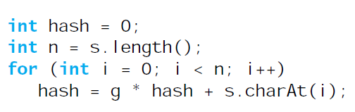
Horner’s Method
Hash code for a string example:
Java code to do this:

Slide 35
Examples of hash functions
Hash a list of classmates’ phone numbers
Use first 3 digits
Bad
Consider phone number a single int and take value modulo m
Better
Hash a list of words
Add up the ASCII values
Bad
Use Horner’s method to do modular hashing (next slide)
Better
Hash a list of item prices (e.g., $10.54)
(Price * 100) % 1000
Bad
(Price * 100) % 101
Better

Slide 36
Compressing a Hash Code
Common way to scale an integer
Use Java % operator, code % n
Best to use an odd number for n
Prime numbers often give good distribution

Slide 37
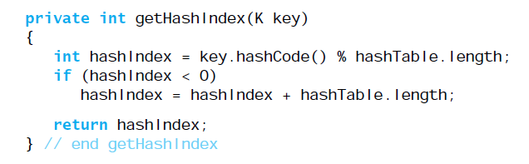
Modular Hashing

Slide 38
Resolving Collisions
Collision: hash function maps search key into a location in hash table already in use
Two choices:
Use another location in the hash table (open addressing)
Change the structure of hash table
each location can represent multiple values (closed addressing)

Slide 39
Open Addressing
Table locations checked in a probe sequence
Probe sequence has to be consistent and predictable
so that entries can be located later
Linear probing
Resolves a collision by examining consecutive locations
Beginning at original hash index
Find the next available one
Until an open space is found
If probe sequence reaches end of table, go to beginning of table (circular)
Open or closed addressing?

Slide 40
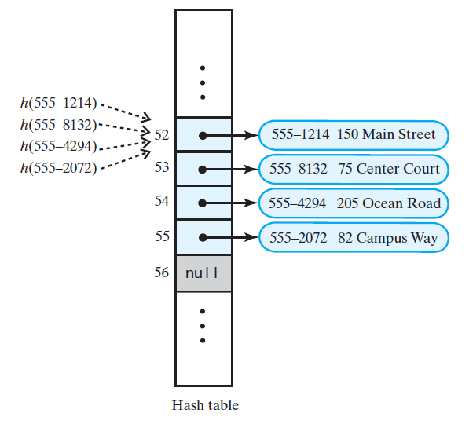
Linear Probing
555-1264

Slide 41
Search with Linear Probing
If another key is stored at index i = hash(key)
Check i+1, i+2, i+3 … until
Key is found
Empty location is found
We circle through the buffer back to i
555-1264

Slide 42
Linear probing example
h(x) = x mod 11
Insert 14, 17, 25, 37, 34, 16, 26
0
1
2
3
4
5
6
7
8
9
10
34
14
25
37
17
16
26
How would deletes be handled?
What happens if key 17 is removed?
Notes:
Discuss implementing as a symbol table
Delete 17, look for 26
How to resolve?
Could flag deleted, and eventually redo whole table
Or redo rest of the cluster on every delete

